Slide 1



ARTEMIS HACKATHON 2026
TITLE PAGE
Problem Statement No –02
Problem Statement Title-Smart defence through innovation
PS Category- Software
Team Name – ALPHA SQUAD

Slide 2
PROBLEM STATEMENT
Problem Overview
Users are increasingly targeted by sophisticated phishing campaigns, malicious URLs, and weaponized QR codes. There is a lack of simple, real-time tools that analyze and sandbox threats before user interaction.
Who Faces This?
Everyday internet users
Corporate employees
Organizations without strong endpoint security
Current Challenges
Security tools are too complex for non-technical users
QR codes completely hide destination URLs
Traditional blacklists fail against zero-day phishing
Real-World Relevance
Phishing, identity theft, and financial fraud are at an all-time high, causing billions in global losses annually.

Slide 3
PROPOSED SOLUTION
(YOUR IDEA)
  SentinelShield
  An AI-powered Threat Detection system acting as a secure gateway. It provides an isolated Safe Mode sandbox to analyze URLs, text payloads, and QR codes before execution.
  How It Works
  User scans QR or enters suspicious link/text
  Frontend decodes and sends data to API layer
  AI engine (Google Gemini + NLP) evaluates phishing patterns
  System generates a riskScore with explanation
  Severe threats are blocked, logged, and admins alerted
  Key Features
  Secure QR Code Decoding & URL Reveal
  Live Telemetry Dashboard with Safety Scores
  AI Threat Engine for zero-day phishing detection
  Threat Intelligence Command Center (Admin View)
  Automated PDF/CSV Security Reports

Slide 4
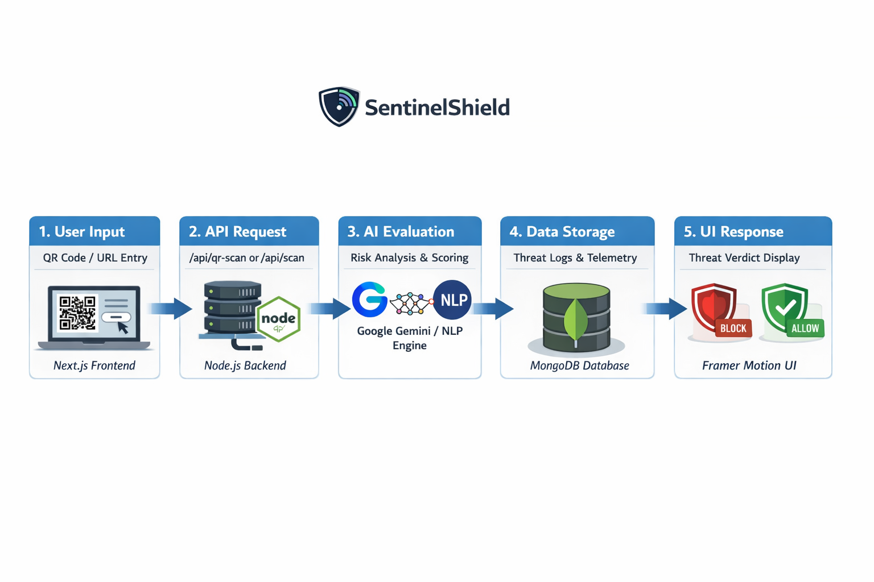
TECHNICAL APPROACH
TECH STACK
FRONTEND : Next.js 16.1 (App Router),React 19, Radix UI,Lucide React,Three.js,Tailwind CSS, Framer Motion, Recharts
BACKEND : Next.js API Routes, Node.js runtime
DATABASE : MongoDB Atlas with Mongoose
AI & ML: Google Gemini API, Natural v8.1 (NLP)
SECURITY : Bcryptjs, JWT, Speakeasy (MFA), Zod
Methodology Flow Chart-

Slide 5
FEASIBILITY AND VIABILITY
Feasibility
Highly feasible using scalable cloud infrastructure (Next.js + MongoDB) and ready AI APIs instead of training models from scratch.
Key Risks
AI false positives/negatives
API latency from external AI calls
Mitigation
Admin Visual Rule Engine (manual override)
URL caching for faster repeat scans

Slide 6
CHALLENGES & RISKS
Evasion Techniques: Hackers constantly evolve their obfuscation techniques to bypass NLP and AI scanners.
Processing Overhead: Evaluating complex payloads via a Python FastAPI microservice can be resource-intensive under heavy traffic.
Data Privacy: Ensuring the text and URLs users submit for scanning do not leak sensitive personal data to third-party AI providers.

Slide 7
IMPACT AND BENEFITS
Potential impact on the target audience: Drastically lowers the success rate of social engineering and phishing attacks by acting as a proactive shield rather than a reactive antivirus.
Benefits of the solution:
  Social: Protects non-technical, vulnerable users from scams and identity theft.
  Economic: Saves corporations millions by preventing data breaches originating from employee endpoints.
  Educational: Provides readable explanations for why a link is dangerous, educating users on cybersecurity in real-time.

Slide 8
TARGET USERS
TARGET USERS-FOR ALL
EXAMPLE:-
Corporate Employees: Examining links in suspicious emails before clicking.
Everyday Citizens: Scanning QR codes in public places (e.g., parking meters, restaurant menus) to ensure they aren't fraudulent.
Security Operations Center (SOC) Analysts / IT Admins: Using the Command Center to monitor network-wide threat telemetry and set automated blocking rules.
Educational Institutions: Protecting students from campus-targeted phishing campaigns.

Slide 9
FUTURE SCOPE
Browser Extension: Build a Chrome/Edge extension to auto-scan web pages and links seamlessly in the background.
Mobile App Integration: Develop a React Native wrapper to provide native QR scanning directly from smartphones.
Federated Threat Sharing: Allow different organizations using SentinelShield to anonymously share zero-day threat data to protect the global network faster.

Slide 10
BUSINESS MODEL / PROFIT STRATEGY
B2C Freemium Model: Basic URL analysis and standard QR scanning are free for everyday users. Advanced AI deep-scans and PDF report generation require a premium subscription.
B2B SaaS Licensing (Enterprise): Tiered subscription models for businesses. Provides access to the Admin Threat Intelligence Command Center, custom visual rule creation, and API integration for their existing SOC.
API as a Service: Charge volume-based pricing to other application developers who want to integrate the SentinelShield AI threat detection endpoint into their own apps.

Slide 11
RESEARCH AND REFERENCES
Global Rise of Phishing & Cybercrime
Phishing and malicious URL attacks are increasing exponentially, especially through QR codes and zero-day domains.
The Federal Bureau of Investigation Internet Crime Report shows billions of dollars lost annually due to phishing and online fraud.
Interpol reports highlight global surges in QR-based phishing and business email compromise.
Verizon Data Breach Investigations Report (DBIR) consistently identifies phishing as the leading initial attack vector
FORMAL REFERENCE LIST
Federal Bureau of Investigation. (Latest). Internet Crime Report.
Verizon. Data Breach Investigations Report (DBIR).
NIST. Cybersecurity Framework (CSF 2.0) & AI Risk Management Framework (AI RMF 1.0).
NATO. (2021). NATO Artificial Intelligence Strategy.
DARPA. Explainable AI (XAI) Program.
General Data Protection Regulation. (2018).
Federal Trade Commission. Consumer Alerts on QR Code Scams.
Europol. Internet Organised Crime Threat Assessment (IOCTA).
IEEE Xplore Digital Library — Research on NLP-based phishing detection.
ACM Digital Library — Web anomaly detection studies.

